Slide 1

Computing Soccer club’s WP&GD
Simple exercise using c++ file stream.
22-Fall TPSC2 2020-16586 Economics Sunah O

Slide 2

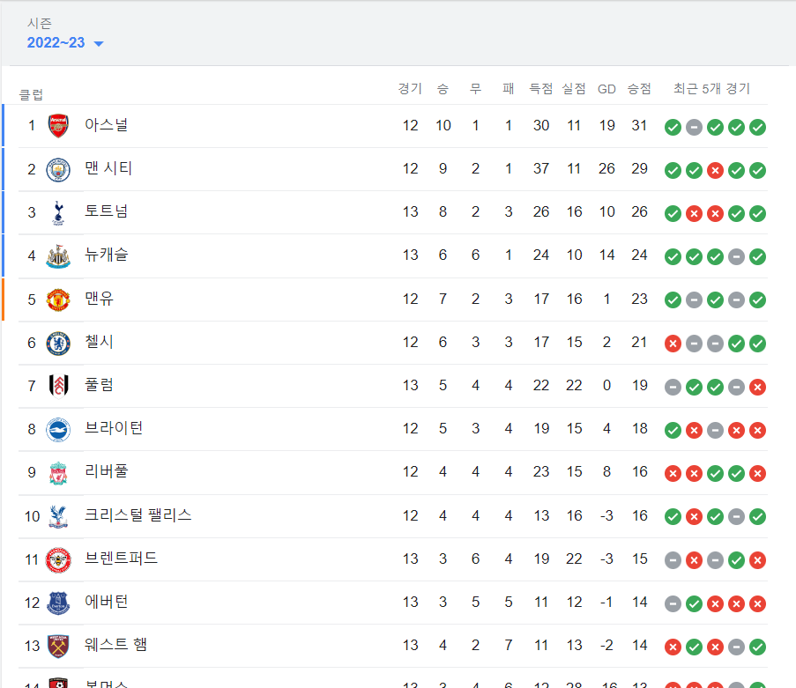
WHAT TO DO?
Every professional soccer league state each club’s winning point & goal difference throughout the season to rate their rank
When we have information of recent match score, could we write a code computing club’s performance?

Slide 3
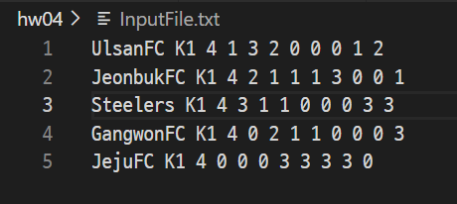
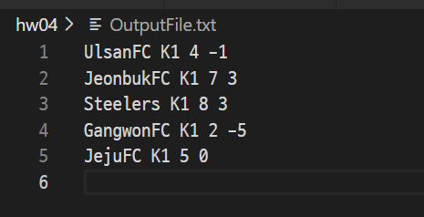
WHAT TO DO?
InputFile.txt
Every professional soccer league state each club’s winning point & goal difference throughout the season to rate their rank
When we have information of recent match score, could we write a code computing club’s performance?
OutputFile.txt

Slide 4





Input Format
_clubName _clubLeague _no_m _matchs
_clubName: name of club
Ex. SeoulFC(K1), The Arsenal Miscellany(EPL) etc
_clubLeague: which league each club belongs
Ex. K1(Korea), EPL(England) etc
_no_m: number of recent matchs
_matchs: vector of recent match scores
Ex. Recent two match 1:0, 2:3 -> _matchs {1, 0, 2, 3}

Slide 5
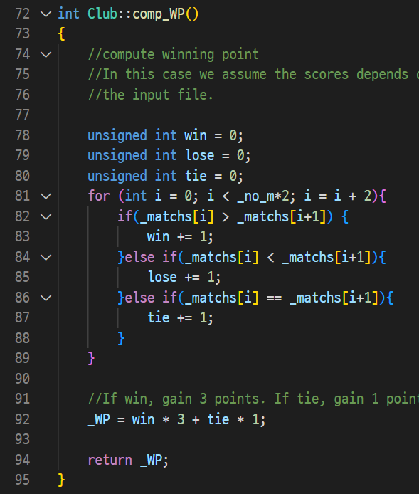
Computing WP & GD
_matchs vector is consist of _no_m *2 element
the odd ones are my score, the even ones are opponent’s score.
WP: If the club wins, they get 3 winning points, else if the club ties, they get 1 winning points, else the club loses, any points are given.

Slide 6
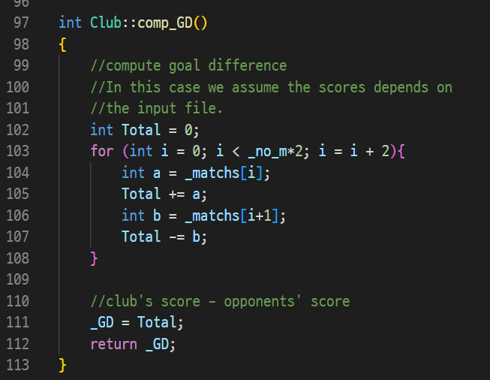
Computing WP & GD
_matchs vector is consist of _no_m *2 element
the odd ones are my score, the even ones are opponent’s score.
GD: Add my score, Subtract opponent’s score.

Slide 7



Output Format
_clubName _clubLeague _WP _GD
_clubName: name of club
_clubLeague: which league each club belongs
_WP: winning point computed
_GD: goal difference computted
_WP is priority rule for rank, _GD is secondary rule for rank
.1. Steelers 2.JeonbukFC 3.JejuFC 4.UlsanFC 5.GangwonFC

Slide 8
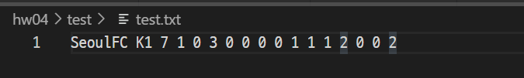
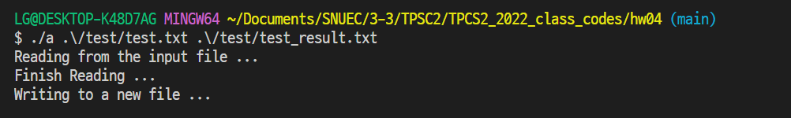
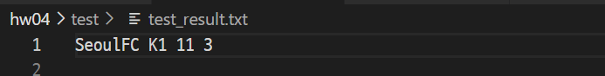
Success Test
Input: test.txt
REAL RESULT
1:0 – win +3
3:0 – win +3
0:0 – tie +1
0:1 – lose x
1:1 – tie +1
2:0 – win +3
0:2 – lose x
WP = 3+3+1+1+3 = 11
(True)
command
Output: test_result.txt
Goal = 1+3+0+0+1+2+0 = 7
Lose score = 0+0+0+1+1+0+2 = 4
GD = 7-4 = 3
(True)

Slide 9


Break?
Input: test.txt
Leak of information
Ex. Recent 7 matchs only 5 scores
command
Output: test_result.txt
Wrong Winning Point! (Bad Result)
-> All null scores become 0 (tie wins 1 point)

Slide 10
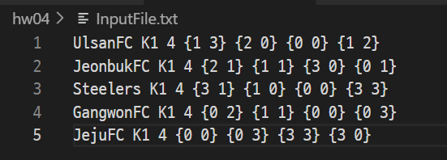
Other Attempt
Input: each match score (ex. 2:0 -> {2,0}) group by pair
My intention : get _matchs as 2 dim vector like {{1,3},{2,0},{0,0},{1,2}} size _no_m * 2
-> fail to materialize (std::vector<std::vector<int>> _matches(_no_m)(2) don’t work)
-> other attempt?

Slide 11

Further Questions
How to solve bad input situation?
How to get n dim data from file stream?
Could we compare WP, GD in one input data? -> compute each league’s rank inside the code
Maybe… add current point variable on input file, expand code as updating points as match goes on

Slide 12



Thank you

